Slide 1

Project Evaluation and Review Technique (PERT): Optimizing Project Performance
Presented by
Name – Aditya Kumar
Roll No. – 34230821034
Dept. – CSE(AI & ML)
3rd year (5th semester)
Future Institute of Technology

Slide 2
1. Introduction
Welcome to the world of Project Evaluation and Review Technique (PERT)! In this presentation, we will explore how PERT can help optimize project performance. We'll cover the basics, benefits, and key steps involved in implementing PERT. Get ready to take your project management skills to the next level!
What is PERT?
In project management, the Project Evaluation Review Technique, or PERT, is used to identify the time it takes to finish a particular task or activity. It is a system that helps in the proper scheduling and coordination of all tasks throughout a project. It also helps in keeping track of the progress, or lack thereof, of the overall project. In the 1950s, the Project Evaluation Review Technique was developed by the US Navy to manage the Polaris submarine missile program of their Special Projects Office.
Aditya Kumar,34230821034

Slide 3
Characteristics of PERT
The main characteristics of PERT are as following :
It serves as a base for obtaining the important facts for implementing the decision-making.
It forms the basis for all the planning activities.
PERT helps management in deciding the best possible resource utilization method.
PERT take advantage by using time network analysis technique.
PERT presents the structure for reporting information.
It helps the management in identifying the essential elements for the completion of the project within time.
Key Steps in PERT:-
To effectively use PERT, follow these key steps: Identify project activities and their dependencies. Estimate the duration of each activity. Determine the critical path and identify critical activities. Create a PERT chart to visualize the project timeline. Monitor and update the PERT chart as the project progresses.
Aditya Kumar,34230821034

Slide 4
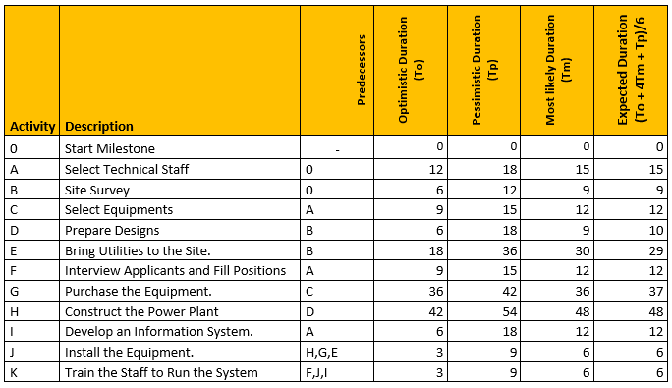
The PERT Method Example
In the following PERT Method Example, you are a project manager of a power plant project. You tracked the steps mentioned above and listed the following inputs;
All the Activities, Predecessors
Optimistic, Pessimistic, and Most Likely Activity Durations By using “The Pert Formula = (To + 4Tm + Tp)/6”, you calculated the expected duration for each activity. All the inputs are listed in the table below.
ADITYA KUMAR, 34230821034

Slide 5
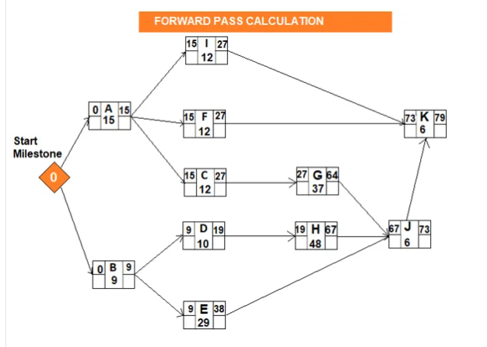
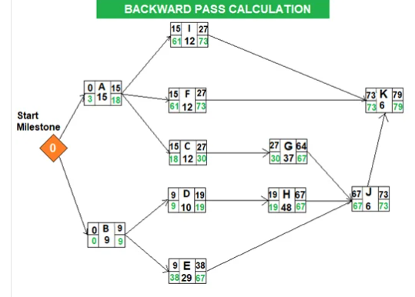
After building a network diagram and estimating the
activity durations, you will determine the critical path
by making forward and backward pass calculations.
Forward Pass Calculations specify the minimum dates
at which each activity can be performed and,
ultimately, the minimum duration of a project.
Backward Pass Calculations of Program Evaluation and Review Technique determine the latest dates by which each activity can be performed without increasing the project’s minimum duration.
Aditya Kumar,34230821034

Slide 6
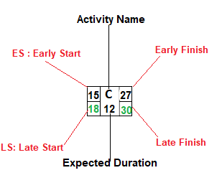
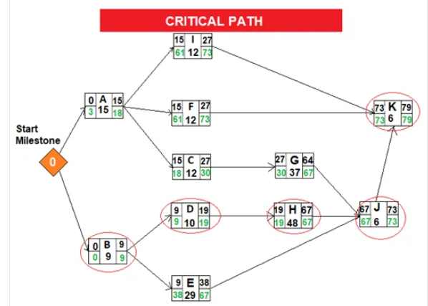
After completing the backward pass calculation, you can easily determine the critical path. In
project management, “float” or “slack” is the amount of time that a task can be delayed without
affecting the deadlines of other subsequent tasks, or the project’s final delivery date. Total
float/slack is 0 on the critical path.
The total float can be calculated by subtracting the Early Start date of an activity from its Late Start date or Early Finish date from its Late Finish date.
Total Float: LS – ES = 18-15 = 3 Total Float: LF – EF = 30-27 = 3
When we analyze the network diagram we will see that there are some paths and every path have duration. The critical path is the longest path in the network diagram and the total float of the critical path is zero.

Slide 7
5.Advantages & Disadvantages of PERT
ADVANTAGES:- It helps maximize the use of resources. It makes project planning more manageable. It’s useful even if there is little or no previous schedule data. It enables project managers to better estimate or determine a more definite completion date. | DISADVANTAGES:- In complex projects, many find PERT hard to interpret, so they may also use a Gantt chart, another popular method for project management. It can be tedious to update, modify, and maintain the PERT diagram. It entails a subjective time analysis of activities and, for those who are less experienced or are biased, this may affect the project’s schedule.
Aditya Kumar,34230821034

Slide 8
6. Conclusion
Mastering PERT is crucial for optimizing project performance. By leveraging PERT's ability to identify critical activities, estimate project duration, and allocate resources effectively, project managers can ensure successful project outcomes. Start implementing PERT in your projects and witness the positive impact it can have on project management.
THANK YOU!
Aditya Kumar,34230821034

